Slide 1
ELECTRIC
MOTOR DRIVES
Graduation Project
Spring 2025

Slide 2

ELECTRIC
MOTOR DRIVES
DEPARTMENT OF ELECTRICAL POWER
AND MACHINES ENGINEERING
Graduation Project
Supervised by
    Dr. Ayman Samy
    Dr. Ahmed Salah
    Dr. Ragy Hamdy
Spring 2025

Slide 3
DEPARTMENT OF ELECTRICAL POWER
AND MACHINES ENGINEERING
ELECTRIC
MOTOR DRIVES
Graduation Project
Prepared by
    AHMED ASHRAF ELSAIAD
    HASAN TAMER HASAN
    KHALED YOUSRY ELGEDDAWY
    MAZEN AL-SAYED AHMED
    MOHAMMAD ISMAIL MOHAMMAD
    MOHAMMAD SALAH ELNAGGAR
    MOHAMMAD ABDALLAH IBRAHIM
    MOHAMMAD ALI EL-SAYED
    MOSTAFA MOHAMMAD HASAN
    MOSTAFA ABDEL-NABI ELNAGGAR
Spring 2025

Slide 4
ELECTRIC
MOTOR DRIVES

Slide 5
PROJECT OBJECTIVE
ELECTRIC MOTOR DRIVES
Design, implement, and analyze control strategies for modern electric motor drives utilized in industrial and automotive applications.

Slide 6
Phase 03
Phase 02
Phase 01
ELECTRIC MOTOR DRIVES
The project was executed in three main phases

Slide 7
Phase 01
Phase 02
Phase 03
ELECTRIC MOTOR DRIVES
System Study and Simulation
Hardware Implementation
Experimental Validation

Slide 8

Phase 01 - System Study and Simulation
Phase 03
Phase 02
Phase 01
Selection of the motor type and control technique:
  Dynamic Discrete Field-Oriented Control (FOC) for PMSM
    Current Control
    Speed Control
  Trapezoidal Control for BLDC
Analysis and modeling using MATLAB/Simulink
ELECTRIC MOTOR DRIVES

Slide 9
Motor Types in Electric Vehicles (EVs)
Permanent Magnet Synchronous Motor (PMSM)
Brushless DC Motor (BLDC)
Induction Motor (IM)
ELECTRIC MOTOR DRIVES

Slide 10
WHY PMSM?
ELECTRIC MOTOR DRIVES

Slide 11
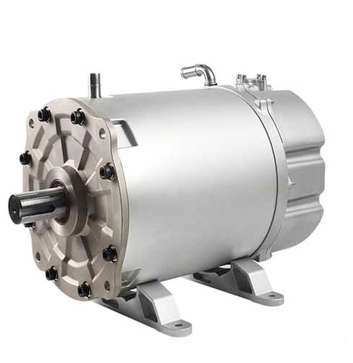
WHY PMSM?

Slide 12
Why PMSM?
Higher efficiency
Better Torque to Weight Ratio
Superior dynamic response
Smooth and stable torque at low speeds
Widely used in modern EVs (e.g., Tesla)

Slide 13
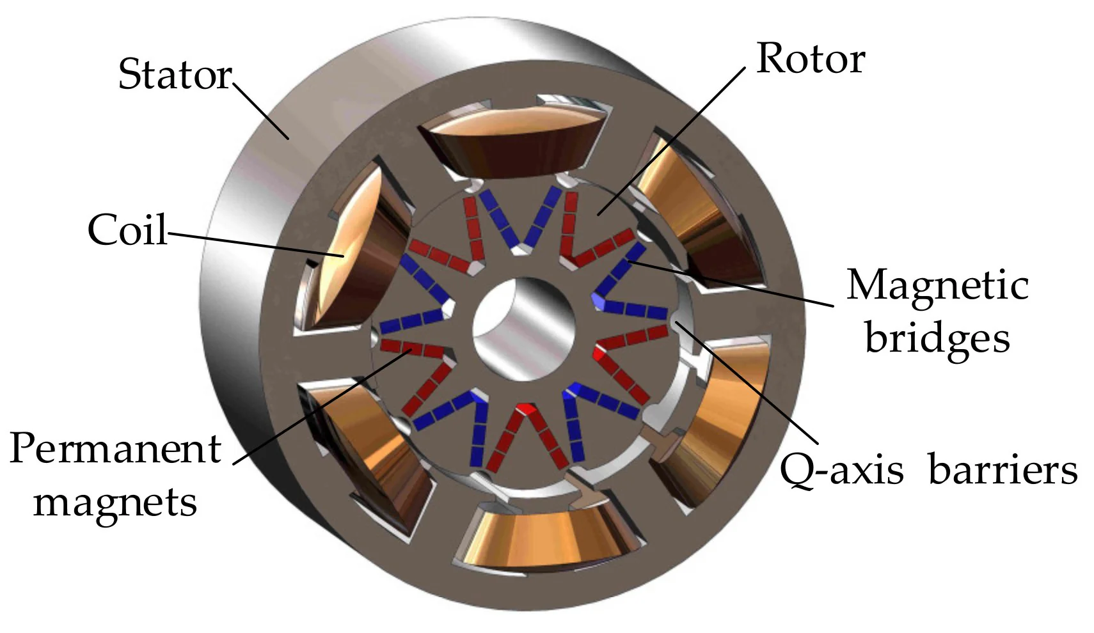
Why PMSM?

Slide 14
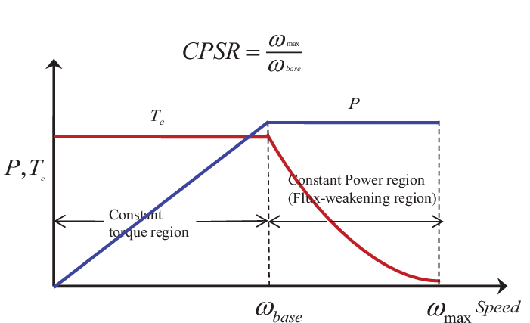
Torque-Speed Curve

Slide 15
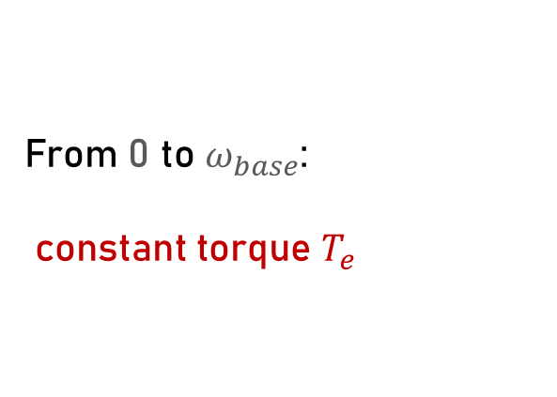
Torque-Speed Curve
From 0 to $ω_{base}$:
constant torque $T_{e}$

Slide 16
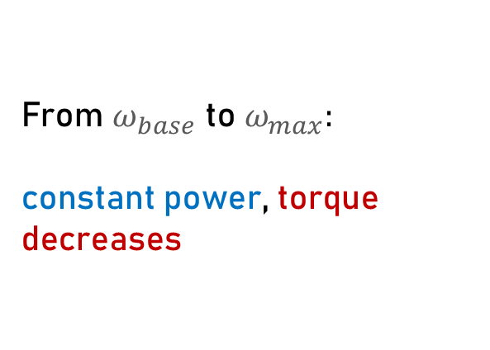
From $ω_{base}$ to $ω_{max}:$
constant power, torque decreases
Torque-Speed Curve

Slide 17
To increase speed beyond base speed, field weakening is applied
Torque-Speed Curve

Slide 18
Torque-Speed Curve

Slide 19
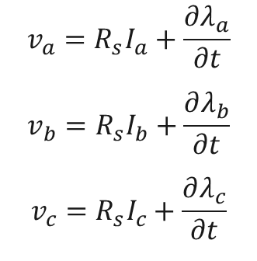
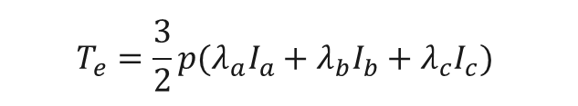
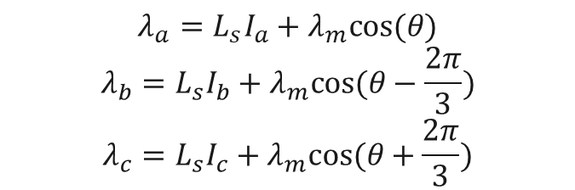
Mathematical Equations
Voltage Equations
Flux Linkage Equations
$$λ_{a}=L_{s}I_{a}+λ_{m}cos⁡(θ)$$
$$λ_{b}=L_{s}I_{b}+λ_{m}cos⁡(θ−\frac{2π}{3})$$
$$λ_{c}=L_{s}I_{c}+λ_{m}cos⁡(θ+\frac{2π}{3})$$
$$v_{a}=R_{s}I_{a}+\frac{∂λ_{a}}{∂t}$$
$$v_{b}=R_{s}I_{b}+\frac{∂λ_{b}}{∂t}$$
$$v_{c}=R_{s}I_{c}+\frac{∂λ_{c}}{∂t}$$
$$T_{e}=\frac{3}{2}p(λ_{a}I_{a}+λ_{b}I_{b}+λ_{c}I_{c})$$
Electromagnetic Torque Equation

Slide 20
Why Used d-q Axis?
ELECTRIC MOTOR DRIVES
Clarke & Park Transformations

Slide 21
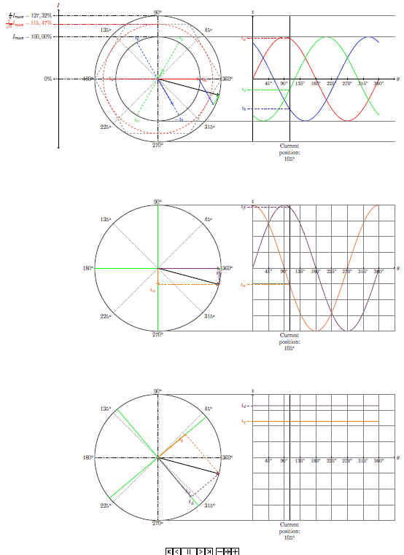
Clarke & Park Transformations

Slide 22
Clarke & Park Transformations
Simplifies control of AC machines by converting AC variables to DC-like variables
Transforms rotating 3-phase system (abc) into a 2-axis orthogonal frame (dq)
Makes control similar to a DC motor → easier PI design

Slide 23
Clarke & Park Transformations
Enables decoupled control of torque and flux:
  controls flux
  controls torque
Essential for Field-Oriented Control (FOC)
Coordinates rotate with rotor → steady-state values become constant

Slide 24

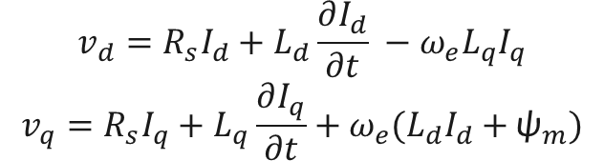
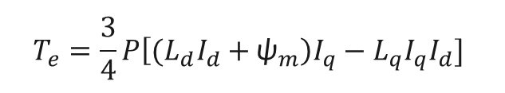
Mathematical Equations (dq axis)
Voltage Equations
$$v_{d}={R_{s}I_{d}+L}_{d}\frac{∂I_{d}}{∂t} −ω_{e}L_{q}I_{q}$$
$$v_{q}={R_{s}I_{q}+L}_{q}\frac{∂I_{q}}{∂t}+ω_{e}{(L}_{d}I_{d}+{\text{ψ}}_{m})$$
Electromagnetic Torque Equation
$$T_{e}=\frac{3}{4}P\left[{(L}_{d}I_{d}+{\text{ψ}}_{m}\right)I_{q}−L_{q}I_{q}I_{d}]$$
$$T_{e}−T_{L}=B ω_{m}+J\frac{∂ω_{m}}{∂t}$$
Speed Equation

Slide 25

Analysis and modeling using MATLAB/Simulink

Slide 26
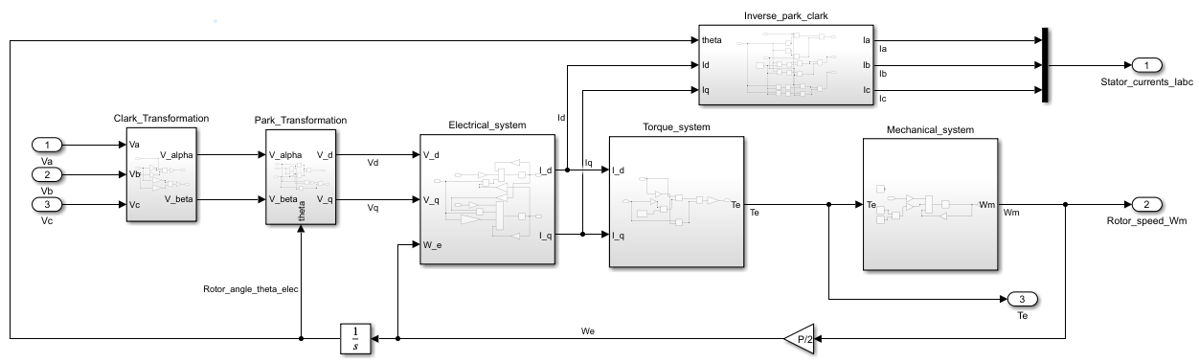
PMSM Modeling in Simulink

Slide 27
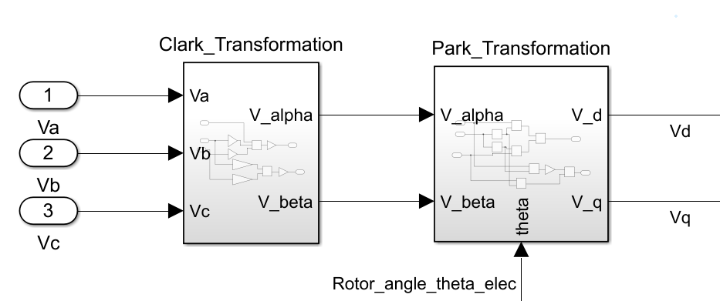

PMSM Modeling in Simulink
Clark Transformation : Convert ${(v}_{a},v_{b},v_{c}) to{ (v}_{α},v_{β}$)
Park Transformation : Convert${(v}_{α},v_{β}) to{(v}_{d},v_{q}$)

Slide 28
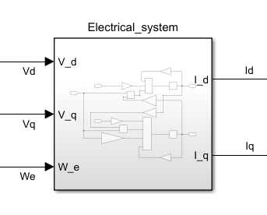
PMSM Modeling in Simulink

Slide 29
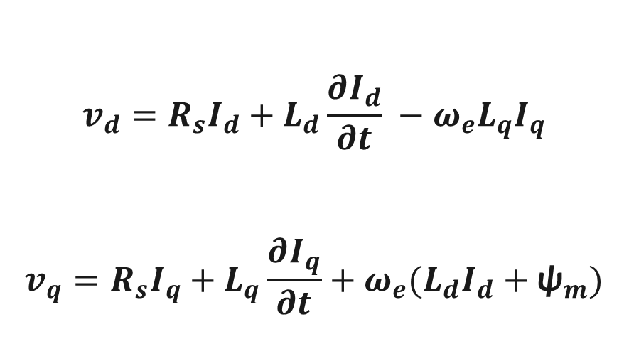
PMSM Modeling in Simulink
$$v_{d}={R_{s}I_{d}+L}_{d}\frac{∂I_{d}}{∂t} −ω_{e}L_{q}I_{q}$$
$$v_{q}={R_{s}I_{q}+L}_{q}\frac{∂I_{q}}{∂t}+ω_{e}{(L}_{d}I_{d}+{\text{ψ}}_{m})$$

Slide 30
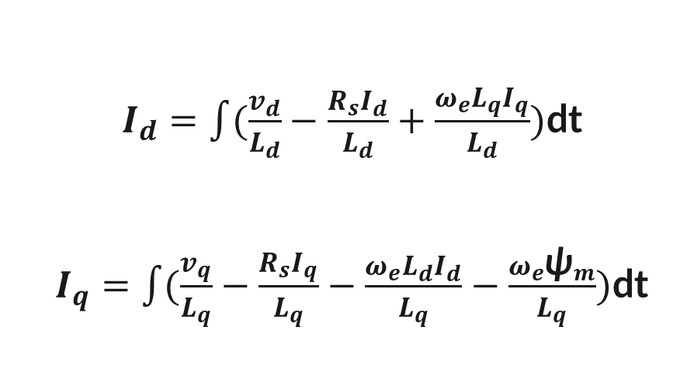
PMSM Modeling in Simulink
$I_{d}=\int{(\frac{v_{d}}{L_{d}}}−\frac{R_{s}I_{d}}{L_{d}}+\frac{ω_{e}L_{q}I_{q}}{L_{d}})$dt
$I_{q}=\int{(\frac{v_{q}}{L_{q}}}−\frac{R_{s}I_{q}}{L_{q}}−\frac{ω_{e}L_{d}I_{d}}{L_{q}}−\frac{ω_{e}{\text{ψ}}_{m}}{L_{q}})$dt

Slide 31
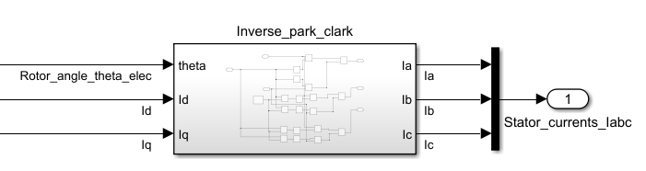
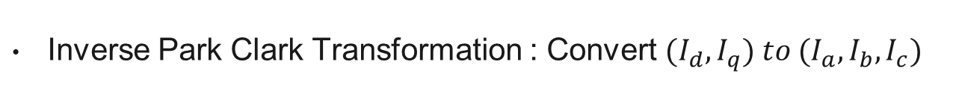
PMSM Modeling in Simulink
Inverse Park Clark Transformation : Convert ${(I}_{d},I_{q}) to {(I}_{a},I_{b},I_{c})$

Slide 32
PMSM Modeling in Simulink
First Output

Slide 33
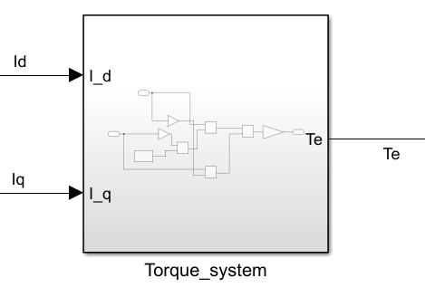
PMSM Modeling in Simulink

Slide 34
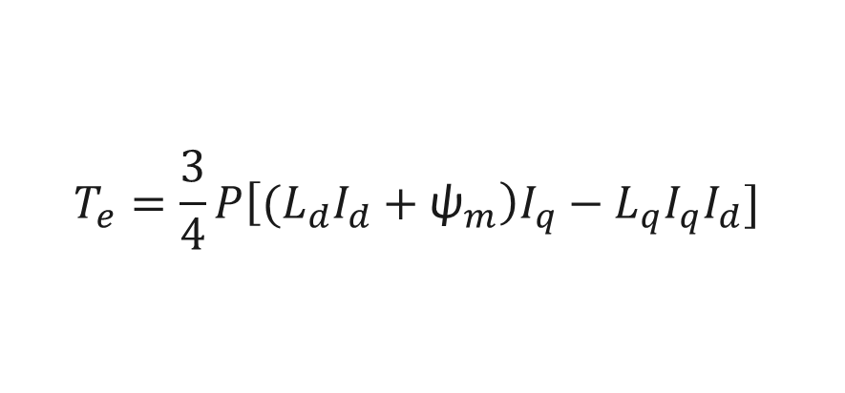
PMSM Modeling in Simulink
$$T_{e}=\frac{3}{4}P\left[{(L}_{d}I_{d}+{\text{ψ}}_{m}\right)I_{q}−L_{q}I_{q}I_{d}]$$
Second Output

Slide 35
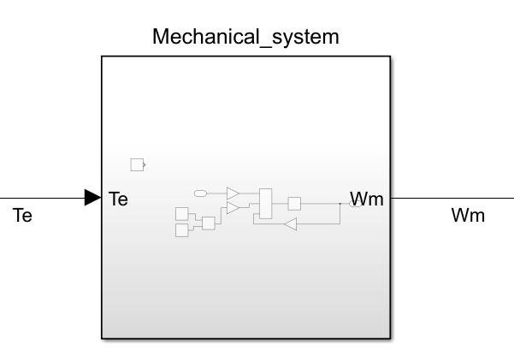
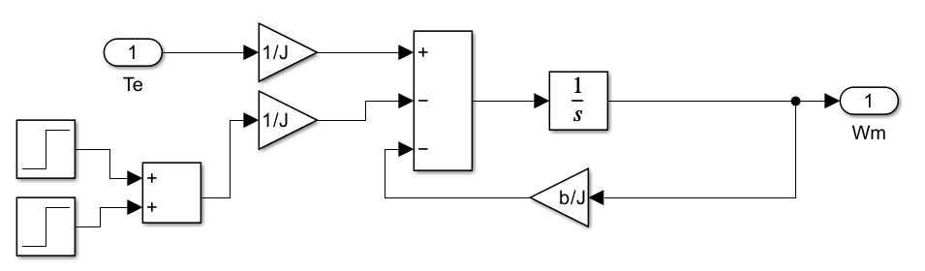
PMSM Modeling in Simulink

Slide 36
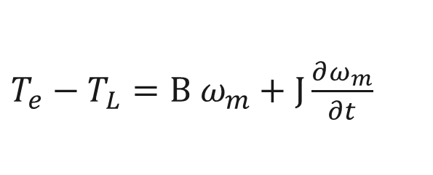
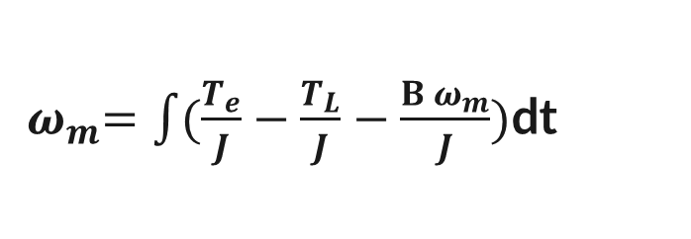
PMSM Modeling in Simulink
$T_{e}−T_{L}=B ω_{m}+J\frac{∂ω_{m}}{∂t}$
${ ω}_{m}=\int{(\frac{T_{e}}{J}}−\frac{T_{L}}{J}−\frac{B ω_{m}}{J})$dt
Third Output

Slide 37
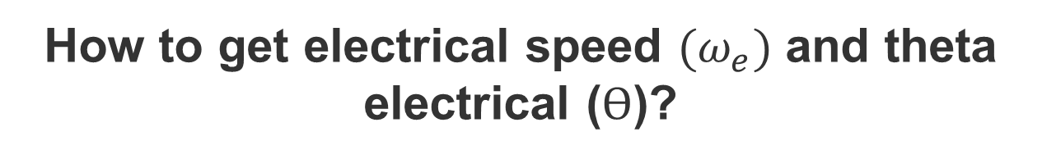
PMSM Modeling in Simulink
How to get electrical speed ${(ω}_{e})$ and theta electrical ($ϴ$)?

Slide 38
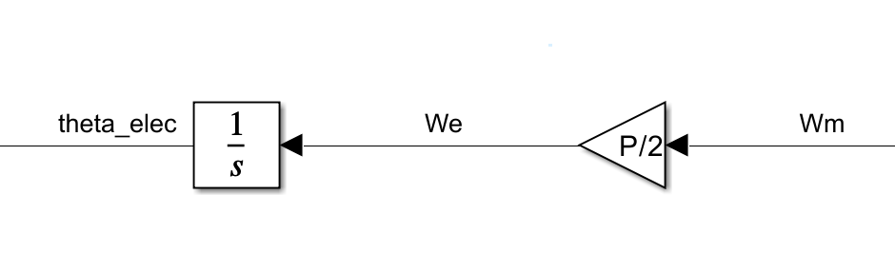
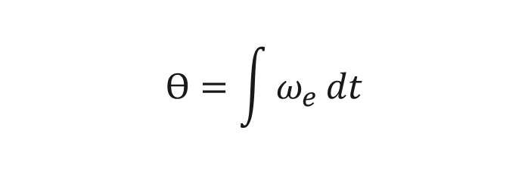
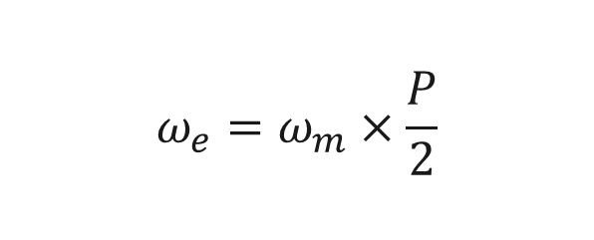
PMSM Modeling in Simulink
$$ω_{e}=ω_{m}×\frac{P}{2}$$
$$ϴ=\int{ω_{e}}dt$$

Slide 39
PMSM Modeling in Simulink

Slide 40
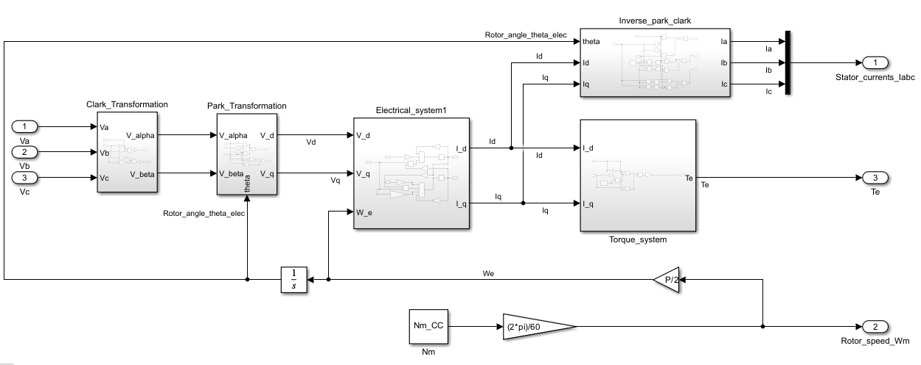
PMSM Modeling in Simulink
Model Modifications for Current Control

Slide 41
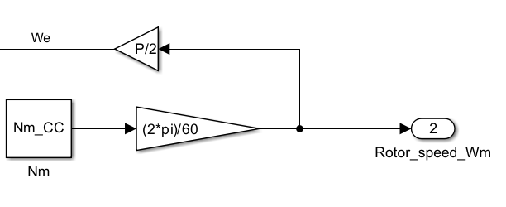
PMSM Modeling in Simulink
Model Modifications for Current Control
For Speed Control
For Current Control

Slide 42
Why Current Control?
FOC has two loops:
  Inner loop: current control (fast dynamics)
  Outer loop: speed control (slower dynamics)
Torque is directly related to iq → needs precise current control
Stable current control is foundation for accurate speed control

Slide 43
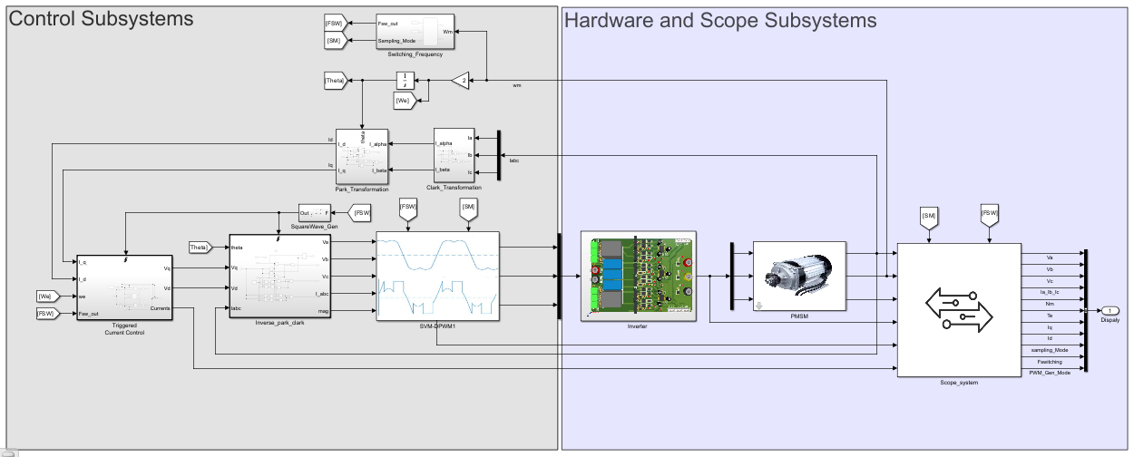
Current Control

Slide 44
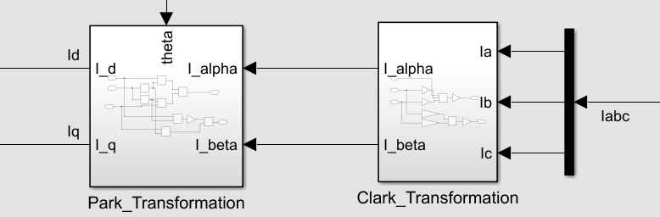
Current Control
Clark Park Transformatin

Slide 45
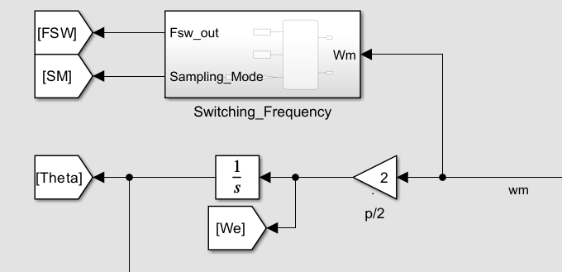
Current Control
Calculate $ω_{e}\&ϴ \& Swithing Frequency$

Slide 46
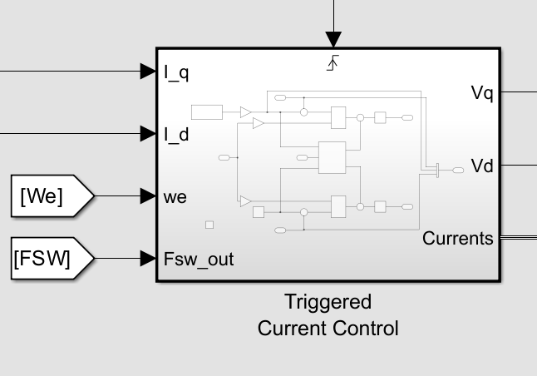
Current Control
Triggered Current Control

Slide 47
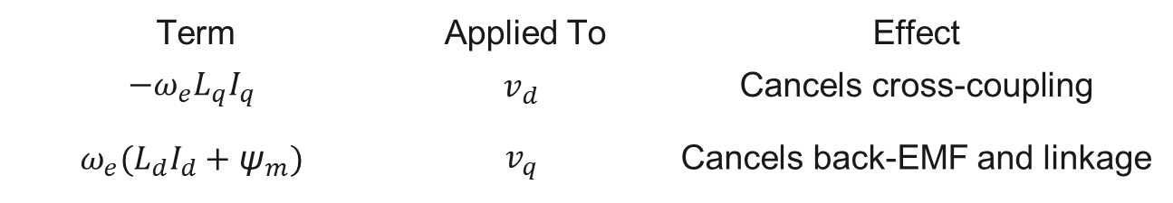
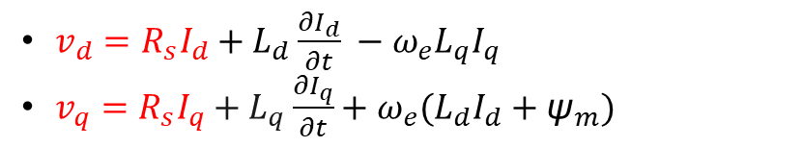
Current Control
Triggered Current Control (Why Feedforward)
$v_{d}={R_{s}I_{d}+L}_{d}\frac{∂I_{d}}{∂t} −ω_{e}L_{q}I_{q}$
$v_{q}={R_{s}I_{q}+L}_{q}\frac{∂I_{q}}{∂t}+ω_{e}{(L}_{d}I_{d}+{\text{ψ}}_{m})$
Term | Applied To | Effect
$${−ω}_{e}L_{q}I_{q}$$ | $$v_{d}$$ | Cancels cross-coupling
$$ω_{e}{(L}_{d}I_{d}+{\text{ψ}}_{m})$$ | $$v_{q}$$ | Cancels back-EMF and linkage

Slide 48
Current Control
Feedforward features
✅ Improves accuracy
✅ Speeds up response
✅ Ensures smoother motor behavior

Slide 49
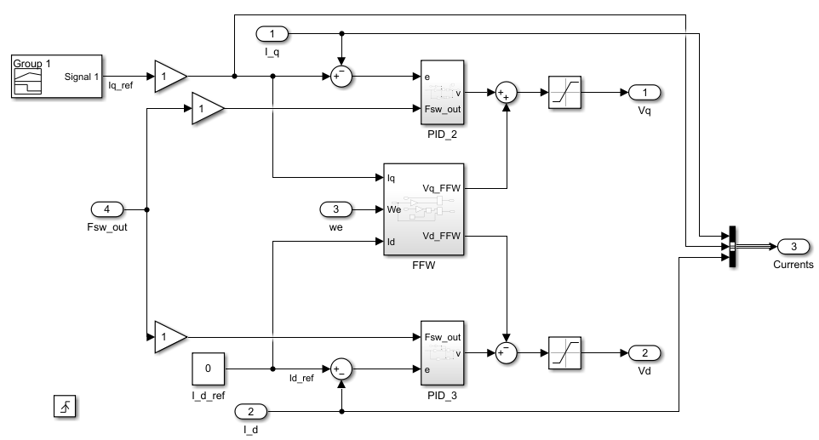
Current Control

Slide 50
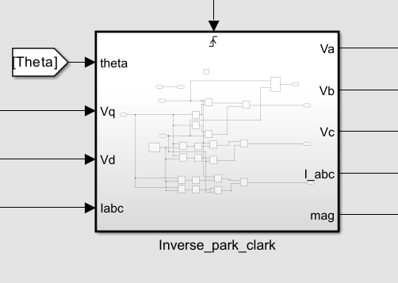
Current Control
Inverse Park Clark Transformation

Slide 51
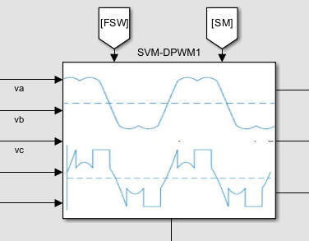
Current Control
PWM Generation

Slide 52
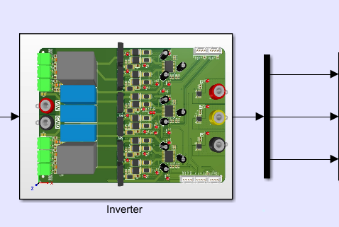
Current Control
Inverter

Slide 53
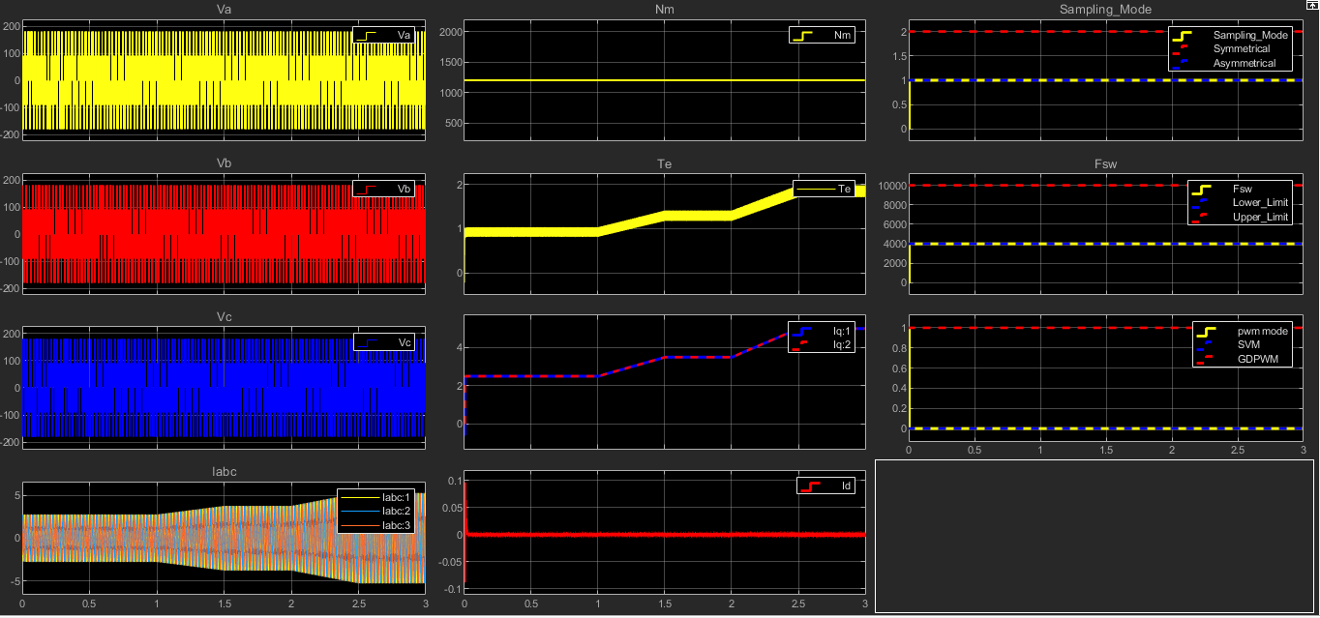
Current Control
Outputs

Slide 54
مصطفي النجار

Slide 55
محمد اسماعيل
SVM & DPWM

Slide 56
Outlier
Introduction to Power Converters
Sinusoidal PWM (SPWM) Fundamentals
Space Vector Modulation (SVM) Theory
Discontinuous PWM (DPWM) Techniques
DPWM Classification & Implementation
Comparative Analysis & Applications
Conclusions

Slide 57
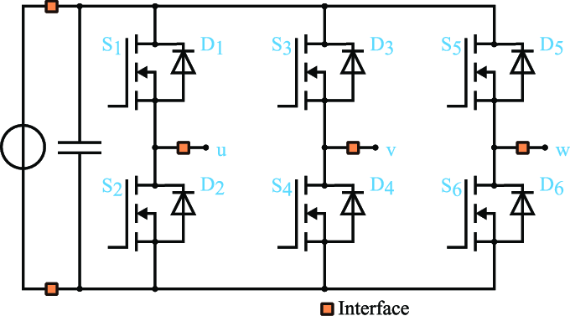
Two-Level Inverter
Topology

Slide 58
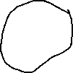
Freewheeling Diodes
Primary Functions:
  Provide safe current path for inductive loads
  Prevent voltage spikes during switching
  Protect semiconductor devices
  Enable continuous current flow in motor windings
Location: Anti-parallel to each switching device

Slide 59
VSC
Voltage Source Converter
In the context of power electronics and electrical engineering, VSC stands for Voltage Source Converter. A Voltage Source Converter is a type of power electronic converter that converts DC voltage to AC voltage or vice versa. It is called a "voltage source" because it is typically connected to a DC voltage source and can supply or absorb power from an AC system.
Key Features of VSCs
Self-Commutated: VSCs use self-commutated devices such as Insulated Gate Bipolar Transistors (IGBTs) or Gate Turn-Off Thyristors (GTOs), which can be turned on and off by a control signal. This allows for flexible control over the output waveform.
Pulse Width Modulation (PWM): VSCs often employ PWM techniques to generate the desired AC waveform from the DC input. PWM involves varying the width of the pulses to approximate a sinusoidal waveform.
Four-Quadrant Operation: VSCs can operate in all four quadrants of the power plane, meaning they can supply or absorb both real and reactive power. This capability is essential for applications requiring bidirectional power flow.
Control Flexibility: The output of a VSC can be controlled in terms of both magnitude and phase angle, making it suitable for a wide range of applications, including HVDC transmission, renewable energy integration, and active filtering.

Slide 60
VSC
Voltage Source Converter
Applications of VSCs
High Voltage Direct Current (HVDC) Transmission: VSC-based HVDC systems are used for long-distance transmission of bulk power and for connecting asynchronous grids.
Renewable Energy Integration: VSCs are used to integrate renewable energy sources, such as wind and solar power, into the grid.
Flexible AC Transmission Systems (FACTS): VSCs are used in various FACTS devices, like STATCOMs, to provide reactive power compensation and voltage support.
Power Quality Improvement: VSCs can be used to improve power quality by acting as active filters or providing dynamic voltage support.

Slide 61
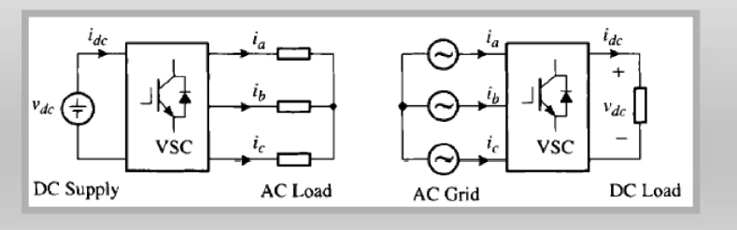
Bidirectional
Power Flow
Whether converter serves as an inverter or a rectifier, the power flow in the converter circuit is bidirectional: the power can flow from its DC side to AC side and vice versa.

Slide 62
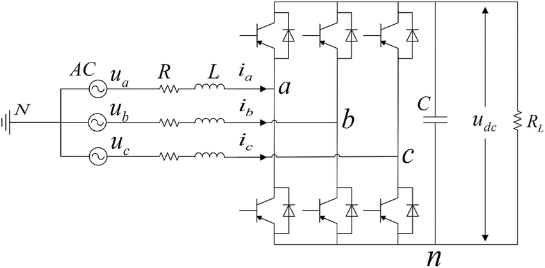
Bidirectional
Power Flow
"Unified Converter Topology"
Same circuit operates as inverter OR rectifier
Freewheeling diodes enable passive rectification
Active switches enable controlled rectification
Applications:
  Regenerative braking in EVs
  Grid-tie renewable energy systems
  Four-quadrant motor drives
  Power Supplies and Uninterruptible Power Supplies (UPS)

Slide 63
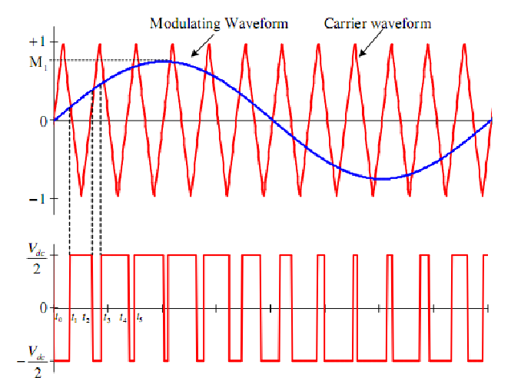
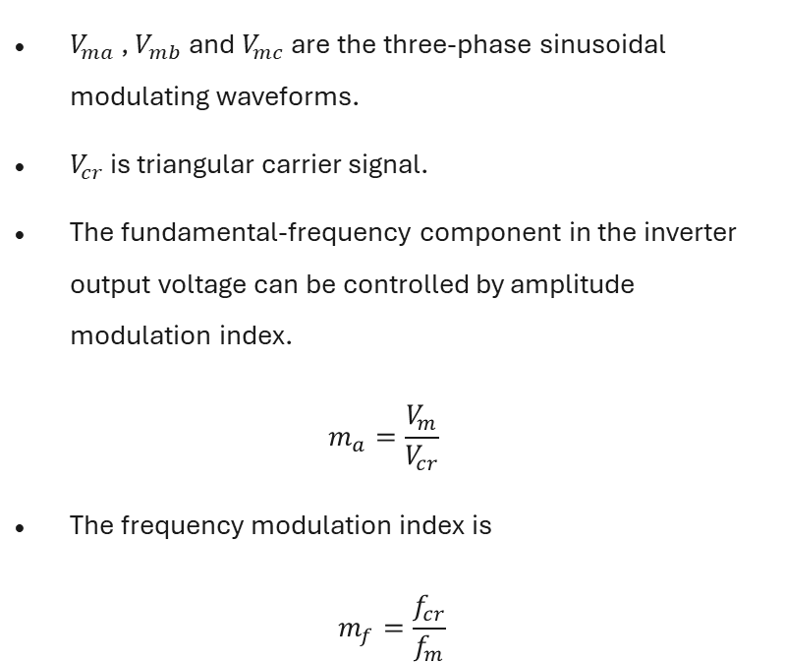
Sinusoidal PWM
SPWM
$V_{ma}$ , $V_{mb}$ and $V_{mc}$ are the three-phase sinusoidal modulating waveforms.
$V_{cr}$ is triangular carrier signal.
The fundamental-frequency component in the inverter output voltage can be controlled by amplitude modulation index.
$$m_{a}=\frac{V_{m}}{V_{cr}}$$
The frequency modulation index is
$$m_{f}=\frac{f_{cr}}{f_{m}}$$

Slide 64
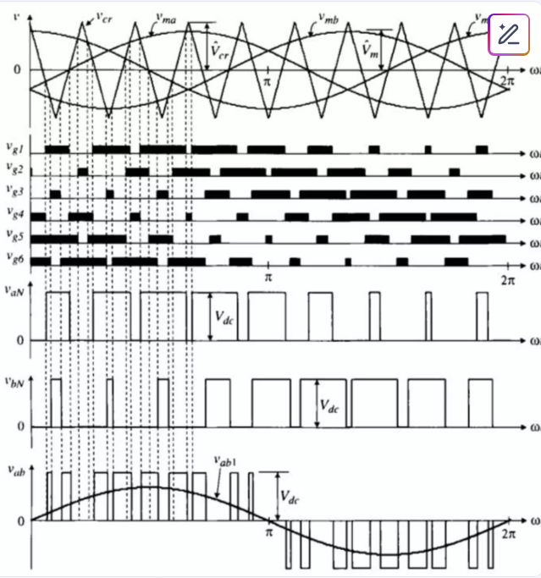
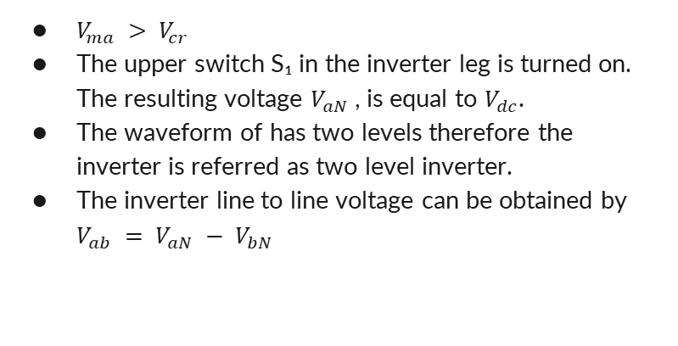
SPWM
$V_{ma} > V_{cr}$
The upper switch S₁ in the inverter leg is turned on. The resulting voltage $V_{aN}$ , is equal to $V_{dc}$.
The waveform of has two levels therefore the inverter is referred as two level inverter.
The inverter line to line voltage can be obtained by $V_{ab} = V_{aN} − V_{bN}$

Slide 65
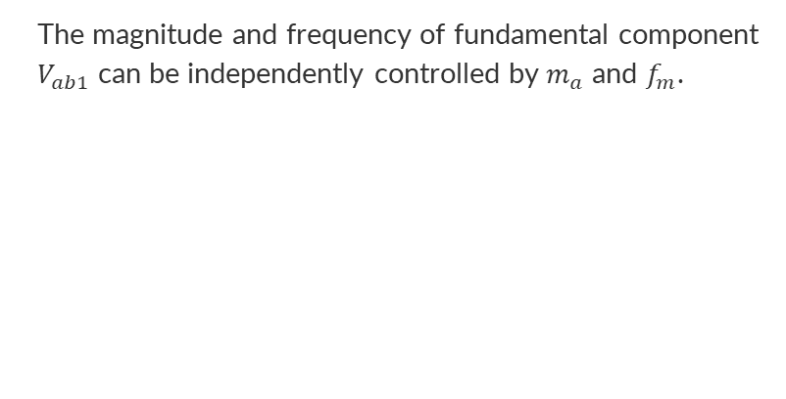
SPWM
The magnitude and frequency of fundamental component $V_{ab1}$ can be independently controlled by$m_{a}$ and $f_{m}$.

Slide 66

SPWM
The switching frequency of the active switches in the two level inverter can be found from
$$f_{sw}= f_{cr}= f_{m}∗ m_{f}$$

Slide 67

SPWM
As you can see here, this produces a two-level output voltage for each phase, switching between zero and Vdc. The line-to-line voltage, shown at the bottom, contains the desired sinusoidal fundamental component plus high-frequency harmonics that we filter out.

Slide 68

Space Vector Theory
Space Vector Modulation takes a different approach.
Instead of treating each phase independently, SVM considers the three-phase system as a single rotating vector.

Slide 69


Space Vector Theory
In order to derive relationship between the space vectors and switching states assume system is balance.
$$v_{a\left(t\right)}+ v_{b\left(t\right)}+ v_{c\left(t\right)}= 0$$

Slide 70


Space Vector Theory
A space vector can be generally expressed in terms of 2-phase voltages in α-β frame
$$\bar{v}\left(t\right) = v_{α\left(t\right)} + jv_{β\left(t\right)}$$
$$\begin{matrix}v_{α\left(t\right)} \\ v_{β\left(t\right)}\end{matrix}=\frac{2}{3}\left[\begin{matrix}1 & −\frac{1}{2} & −\frac{1}{2} \\ 0 & \frac{\sqrt{3}}{2} & \frac{\sqrt{3}}{2}\end{matrix}\right][\begin{matrix}v_{a\left(t\right)} \\ v_{b\left(t\right)} \\ v_{c\left(t\right)}\end{matrix}]$$

Slide 71
Space Vector Theory
In order to derive relationship between the space vectors and switching states assume system is balance.
$$v_{a\left(t\right)}+ v_{b\left(t\right)}+ v_{c\left(t\right)}= 0$$
$$\begin{matrix}v_{α\left(t\right)} \\ v_{β\left(t\right)}\end{matrix}=\frac{2}{3}\left[\begin{matrix}1 & −\frac{1}{2} & −\frac{1}{2} \\ 0 & \frac{\sqrt{3}}{2} & \frac{\sqrt{3}}{2}\end{matrix}\right][\begin{matrix}v_{a\left(t\right)} \\ v_{b\left(t\right)} \\ v_{c\left(t\right)}\end{matrix}]$$

Slide 72


SVM Implementation

Slide 73

SVM Implementation

Slide 74


SVM Implementation
It can be observed that
• The dwell times for the seven segments add up to the sampling period ($T_{s}= T_{a}+ T_{b}+ T_{0}).$
• Design requirement (1) is satisfied. For instance, the transition from [OOO] to [POO] is accomplished by turning $S_{1}$ on and $S_{4}$ off, which involves only two switches.
• The redundant switching states for ${\bar{V}}_{0}$ are utilized to reduce the number of switchings per sampling period. For the $\frac{T_{0}}{2}$ segment in the center of the sampling period, the switching state [PPP] is selected, whereas for the $\frac{T_{0 }}{4}$ segments on both sides, the state [OOO] is used.
• Each of the switches in the inverter turns on and off once per sampling period. The switching frequency $f_{sw}$of the devices is thus equal to the sampling frequency $f_{sp}$, that is, $f_{sw}= f_{sp}=\frac{1}{T_{s}}.$

Slide 75
SVM Implementation
SVPWM is a continuous modulation technique that:
Uses all three phases actively switching throughout the entire fundamental period
Synthesizes the reference voltage vector by combining adjacent active vectors and zero vectors
Provides excellent DC bus utilization (up to 15.5% better than sinusoidal PWM)
Results in lower harmonic distortion

Slide 76

SVM Implementation

Slide 77
DPWM is essentially a modification of SVPWM

Slide 78

DPWM that trades some waveform quality for significant switching loss reduction, making it valuable in high-power applications where efficiency is paramount.

Slide 79
Feature | SVPWM | DPWM
Switching Pattern | Continuous | One phase clamped
Switching Losses | Higher | 33% reduction
THD | Lower | Slightly higher
DC Bus Utilization | Excellent | Excellent

Slide 80
DPWM
One phase is clamped (not switching) to either the positive or negative DC rail for portions of the fundamental period
The clamping typically occurs for 60° or 120° intervals
Only two phases are actively switching during the clamped periods

Slide 81
DPWM
Mathematical Basis: DPWM uses the same space vector concept as SVPWM but modifies the zero vector distribution
  SVPWM typically uses both zero vectors (V₀ and V₇)
  DPWM uses only one zero vector during clamping periods

Slide 82
DPWM
• Starting with SVPWM calculations
• Adding a common-mode signal to clamp one phase
• Redistributing the switching patterns

Slide 83
DPWM
Common DPWM Variants
DPWM1: Clamps during peak current periods (minimum switching losses)
DPWM2: Clamps at 30° phase shift from DPWM1
DPWM3: Clamps during peak voltage periods
DPWMMIN/MAX: Clamps to minimize specific losses

Slide 84

DPWM

Slide 85
DPWM
Reduction in the number of commutations and, consequently, switching losses. For a defined value of allowable switching losses, the effective switching frequency can be increased by 3/2, resulting in a reduction of the RMS value of the mains current harmonics for high modulation index values. Consequently, a reduced filtering effort is required, as DPWM enables the use of smaller inductors and capacitors, contributing to an overall reduction in the size of passive components. This enhances power density and system integration in space-constrained applications.
Equal loading of all the switches, as each switch conducts for 60°, reducing the requirement of thermal management of the semiconductors.
Enhanced DC-bus utilization in motor drive applications leads to a higher output voltage, broadening the motor’s speed range [2]. Moreover, achieving a higher DC-bus utilization is crucial for cost and power density improvements [3]. In grid-tie operations, a higher output voltage is advantageous for optimizing power output from renewable sources, ensuring seamless synchronization with the electrical grid, improving overall power quality, facilitating the integration of multiple energy sources, and efficiently feeding excess power back into the grid [4].

Slide 86

Zero-sequence signal generation for Discontinuous PWM

Slide 87

Zero-sequence signal generation for Discontinuous PWM

Slide 88
Classification of the Discontinuous PWM methods
Continual-clamp PWM (CCPWM) continually clamps each phase to one of the two DC-buses for 60° or 120° duration in each half of the fundamental cycle.
  One saturation of 120°: this corresponds to the methods “120° DPWM with -DC clamping ” or “120° DPWM with +DC clamping“.
  Two saturations of 60°: this corresponds to the methods “60° DPWM clamping“, “60° DPWM with +30° phase shift clamping”, and “60° DPWM with -30° phase shift clamping”. In general, the 60° clamping duration can be positioned anywhere during the voltage cycle. For an arbitrary γ (i.e., 0° ≤ γ ≤ 60°) this results in the expression [5]:
Split-clamp PWM (SCPWM) divides the 60° clamping interval into two sub-intervals, which are not necessarily equal, and fall in two different quarter cycles.
  Four saturation of 30°: this corresponds to the strategy called “30° SCPWM“.

Slide 89


Slide 90
"GDPWM: A Unified PWM Framework"
Encompasses all PWM methods
Two parameters (μ, α) control everything
Enables real-time optimization
Smooth transitions between methods

Slide 91
Adaptive Control: "We can optimize efficiency across the entire operating range by adjusting μ and α based on speed and load."
Thermal Management: "By rotating the clamping angle α slowly, we can distribute losses evenly among all switches."
Acoustic Noise: "The smooth transitions enabled by GDPWM reduce acoustic noise compared to abruptly switching between PWM methods."

Slide 92
GDPWM (Generalized Discontinuous PWM)
├── When μ = 0 → Becomes SVPWM (continuous)
├── When μ = 1 → Becomes pure DPWM
│ ├── Different angles (α) give different DPWM types:
│ │ ├── α = 0° → DPWM1
│ │ ├── α = 30° → DPWM0 (DPWMMIN)
│ │ ├── α = -30° → DPWM2
│ │ └── α = 90° → DPWM3 (DPWMMAX)
└── When 0 < μ < 1 → Hybrid operation

Slide 93
Operating Mode Selection: -
High Speed/High Load: μ = 1, α = 0° (DPWM1) → Maximum efficiency
Medium Speed: μ = 0.5-0.8 → Balanced performance
Low Speed/Light Load: μ = 0 (SVPWM) → Best waveform quality

Slide 94
حسن

Slide 95
Why Adaptive Switching Frequency?
ELECTRIC MOTOR DRIVES

Slide 96

Why Adaptive Switching Frequency?

Slide 97

Why Adaptive Switching Frequency?

Slide 98


Theoretical Foundations and Power Loss Analysis
Switching Losses in Power Devices
$$P_{sw}=\frac{1}{2}V_{dc}I_{avg}f_{sw}(t_{on}+t_{off})$$
Motor Speed–Frequency Relationship
$$N_{s}=\frac{120f_{\text{input}}}{P}$$

Slide 99


Adaptive Switching Frequency Logic
Normal Operation: Symmetric PWM Mode
Condition
$$F_{low}≤F_{input}≤F_{high}$$
Control Rule
$$F_{sw}=F_{input}×K$$

Slide 100


Adaptive Switching Frequency Logic
High-Speed Range: Clamped Frequency Mode
Condition
$$F_{input}>F_{high}$$
Control Rule
$$F_{sw}=F_{max}$$

Slide 101


Adaptive Switching Frequency Logic
Low-Speed Range: Asymmetric PWM Mode
      Case A: Moderate Drop (Adaptive Asymmetric Control)
Condition
$F_{input}<F_{low}$ & $F_{input}>F_{crit}$
Control Rule
$$F_{sw}=2F_{input}$$

Slide 102


Adaptive Switching Frequency Logic
Low-Speed Range: Asymmetric PWM Mode
      Case B: Critical Frequency (Stability Protection Mode)
Condition
$F_{input}<F_{low}$ & $F_{input}<F_{crit}$
Control Rule
$$F_{sw}=F_{min}$$

Slide 103

Adaptive Switching Frequency Logic

Slide 104

PWM Sampling Strategies
Asymmetric Sampling:

Slide 105

PWM Sampling Strategies
Symmetric Sampling:

Slide 106

Adaptive Switching Frequency Logic

Slide 107

Adaptive Switching Frequency Logic

Slide 108

Adaptive Switching Frequency Logic

Slide 109
MTPA
ELECTRIC MOTOR DRIVES

Slide 110


Key Ideas Behind MTPA
1. Torque Equation of PMSM
$$T_{e}=\frac{3}{2}P\left[{(L}_{d}I_{d}+{\text{ψ}}_{m}\right)I_{q}−L_{q}I_{q}I_{d}]$$
2. Saliency and Torque Generation
In motors with saliency (i.e., $L_{d}≠L_{q}$, such as IPM motors), both $I_{d}$ and$I_{d}$ contribute to torque.
3. MTPA Objective
MTPA aims to minimize the stator current magnitude for a given torque:
$$I_{s}=\sqrt{I_{d}^{2}+I_{q}^{2}}$$
Lower${ I}_{s}$ → Lower copper losses → Higher efficiency.

Slide 111


MTPA control implementation in FOC loop

Slide 112

MTPA control implementation in FOC loop in Table

Slide 113

MTPA control implementation in FOC loop in Equations

Slide 114

MTPA

Slide 115



MTPA

Slide 116
BLDC MOTOR
ELECTRIC MOTOR DRIVES

Slide 117
WHY BLDC ?
ELECTRIC MOTOR DRIVES

Slide 118

WHY BLDC ?

Slide 119
WHY BLDC MOTOR ?
High Efficiency:
No brushes means less frictional loss.
Ideal for battery-powered and energy-sensitive systems.
High Torque to Weight Ratio :
Permanent magnets produce strong torque in a compact size.
Wide Speed Range:
Efficient at both low and high RPMs.
Suitable for applications requiring high-speed operation.

Slide 120

Torque-Speed Curve

Slide 121
Torque-Speed Curve
Constant Torque Region

Slide 122
Torque-Speed Curve
Constant Power Region

Slide 123
Torque-Speed Curve
Field Weakening Region

Slide 124


Principle of operation

Slide 125



Mathematical Equations
Electrical Model(per phase)
Back-EMF Modeling
$$V_{a}=I_{a}R_{a}+L_{a}\frac{di_{a}}{dt}+e_{a}$$
$$e_{a}=K_{e}.ω.f(θ)$$
Mechanical Dynamic
$$T_{e}−T_{l}=J\frac{dω}{dt}+Bω$$

Slide 126

WHY BACK-EMF IS TRAPEZOIDAL
Concentrated Windings:
Coils are wound tightly around stator teeth.
Magnetic field changes abruptly as rotor poles pass each phase.
The resulting induced voltage (back-EMF) has flat tops and steep edges like a trapezoid.
Magnet Design:
Flat or block magnets produce uniform flux density over parts of the stator.
This creates the “flat” region in the waveform.

Slide 127
Trapezoidal Control & 6-Step Commutation in BLDC Motors
Overview of Trapezoidal Control
Trapezoidal control, also known as 6-step commutation is a method used to control Brushless DC (BLDC) motors. In this method:
      Two of the three motor phases are energized at any one time, with a total of six steps per electrical cycle.
  The commutation is based on rotor position and is synchronized using hall effect sensors.

Slide 128

Back EMF and Motor Torque
Motor torque is proportional to the product of back EMF and current
For a motor with trapezoidal back EMF
To produce maximum torque, current must be supplied only during the flat (constant) region of the trapezoidal back EMF That’s why qusi-square-shaped current pulses are used—to align with the flat portion of the back EMF waveform.
$$T=\frac{E_{b}I}{ω_{m}}$$

Slide 129

Back EMF and Motor Torque

Slide 130
How BLDC Controllers Drive the Motor
At any instant, the controller:
    Applies +Vdc (positive) to one phase
    Grounds another phase (connects to −Vdc)
    Leaves the third phase floating (no current)
This creates a current path through two phases and generates torque by interacting with the rotor's magnetic field.

Slide 131
Six-Step Commutation Table – Two-Phase Conduction for BLDC
Rotor Sector(° ele) | H1 | H2 | H3 | Hall Code | Commutation Step | Phases
0° – 60° | 1 | 0 | 1 | 101 | Step 1 | A+, B–
60° – 120° | 1 | 0 | 0 | 100 | Step 2 | A+, C–
120° – 180° | 1 | 1 | 0 | 110 | Step 3 | B+, C–
180° – 240° | 0 | 1 | 0 | 010 | Step 4 | B+, A–
240° – 300° | 0 | 1 | 1 | 011 | Step 5 | C+, A–
300° – 360° | 0 | 0 | 1 | 001 | Step 6 | C+, B–

Slide 132
Commutation and Torque Generation in BLDC Motors
Torque Production:
Ta, Tb, Tc: Torque from each phase
Torque ripple due to discrete step transitions
Overall torque = sum of phase torques
Hall Sensor Signals:
Three sensors spaced 120°
Digital signals change every 60°
State transitions trigger commutation steps
Key Takeaways:
Maximum torque achieved by aligning square current with flat back-EMF
Commutation occurs at zero-crossings
Simple control using six predefined states
Reliable torque with ~10–15% ripple

Slide 133

Model-Based Development (MBD) and the V-Model
Modeling (MIL - Model-in-the-Loop)
Software-in-the-Loop (SIL)
Hardware-in-the-Loop (HIL)

Slide 134

Modeling (MIL - Model-in-the-Loop)
Mathematical Modeling for BLDC Motor

Slide 135

Modeling (MIL - Model-in-the-Loop)

Slide 136

Modeling (MIL - Model-in-the-Loop)

Slide 137
Modeling (MIL - Model-in-the-Loop)

Slide 138

Simulink Model

Slide 139

Outputs

Slide 140

Outputs

Slide 141
خالد يسري

Slide 142
Flyback

Slide 143

System block diagram highlighting the flyback block

Slide 144

What is a Flyback Converter?
DC-DC converter with galvanic isolation
Uses a transformer to store and transfer energy
Role in Project:
Supplies isolated voltages to each gate driver
Ensures safe and efficient motor control
Basic Flyback converter

Slide 145
Design requirements
Input
Output
Output current
Frequency
100–480V DC
6 × 25V (isolated)
2.5A peak
69kHz
Transformer
Isolation
optocoupler

Slide 146

Design Process

Slide 147


Design Process
Transformer Design
1. Max Duty Cycle Calculation (Dmax_target):
2. Turns Ratio Calculation (Nps_ideal):
3. Inductance Calculation (Lp):

Slide 148


Design Process
Component selection: MOSFET
1. Minimum Required Drain Voltage:
2. Drain Current:
3. Pulsed Current:

Slide 149


Design Process
Component selection: Rectifier Diode
1. Output Blocking Voltage:
2. Output Current (RMS):

Slide 150

Design Process
Simulation: TI Webench Tool

Slide 151
PCB design
Schematic

Slide 152
PCB design
+25V isolated supplies 1&2

Slide 153
PCB design
Feedback circuits

Slide 154


PCB design
Layout

Slide 155


PCB design
Layout Consideration
Minimized switching loops to reduce EMI

Slide 156


PCB design
Layout Consideration
Ensured clearance for isolation

Slide 157

PCB design
Layout Consideration
Optimized thermal management

Slide 158

PCB design
Layout Consideration
Optimized thermal management

Slide 159

PCB design
Testing

